Slide 1

Movie Analysis
1996-2016
Shilpi Ray
Becky Li
Alexis Fox
Bryce Dudka

Slide 2
DATA SOURCE
IMDB 5000 Movie Datset:
https://data.world/ansel/imdb-5000-movie-dataset/workspace/file?agentid=popculture&filename=movie_metadata.csv%2Fmovie_metadata.csv
Rotten Tomato Movie database:
https://www.kaggle.com/ayushkalla1/rotten-tomatoes-movie-database
TMDB 5000 Movie Dataset:
https://www.kaggle.com/tmdb/tmdb-movie-metadata/version/2#
IMDB Top 250 Directors:
https://www.imdb.com/list/ls008344500/

Slide 3
Motivation and summary:
Find multiple data sets from different sources that we could link together to explain impacts on gross movie revenue based on:
Budget
Cast popularity
Director popularity
IMDB user ratings
Ratings (e.g. pg-13, R)
Genre
Studio (e.g. Fox, Paramount)
Rating and popularity of Director

Slide 4
DATA PROCESS - ETL
Search internet data for sources, found several viable sources:
IMDB 5000 Movie Datset
Rotten Tomato Movie database
TMDB 5000 Movie Dataset
IMDB Top 250 Directors
Extract from .csv files into dataframes in Jupyter using Pandas
Transform: cleaned and combined data in Jupyter using Pandas, main issues included:
NULL and 0 values
Extra spaces and foreign characters in movie titles
Mismatched date and currency formatting
Load: into SQL database (postgres)
Analyze: queried database in Jupyter using SQL Alchemy

Slide 5
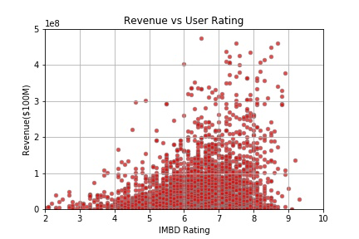
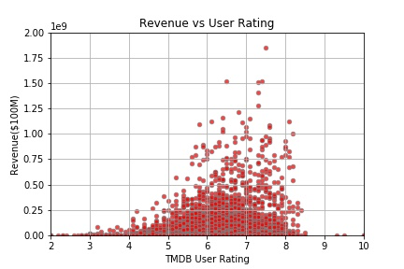
Revenue vs. Ratings- ANALYSIS

Slide 6
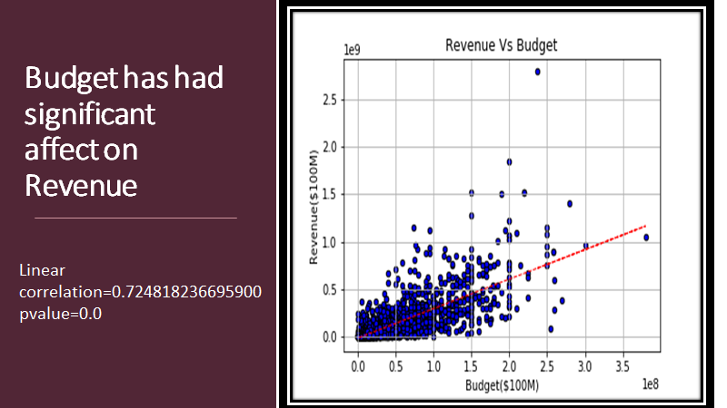
RAVENUE VS BUDGET

Slide 7
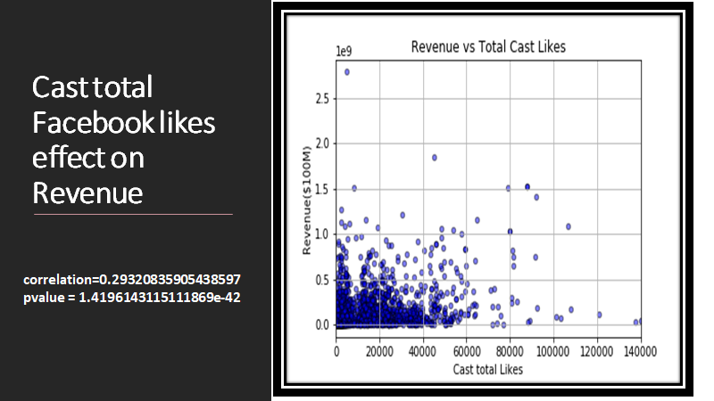

Slide 8
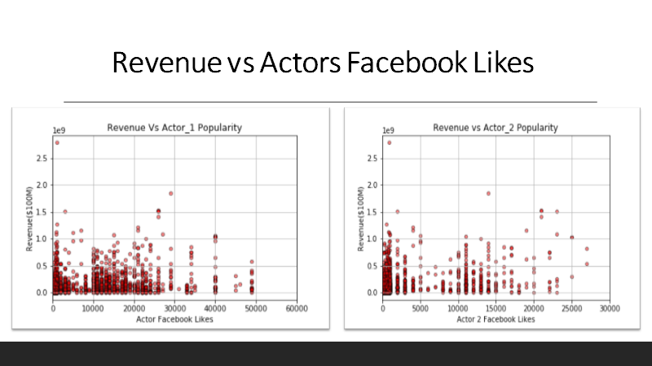

Slide 9
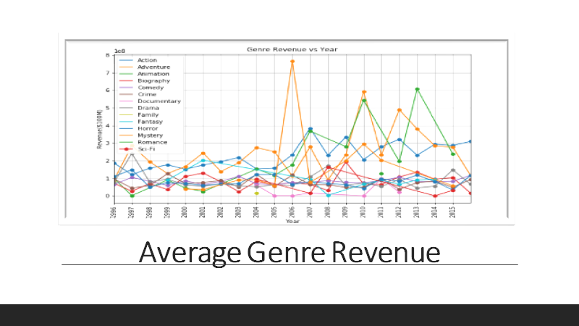

Slide 10
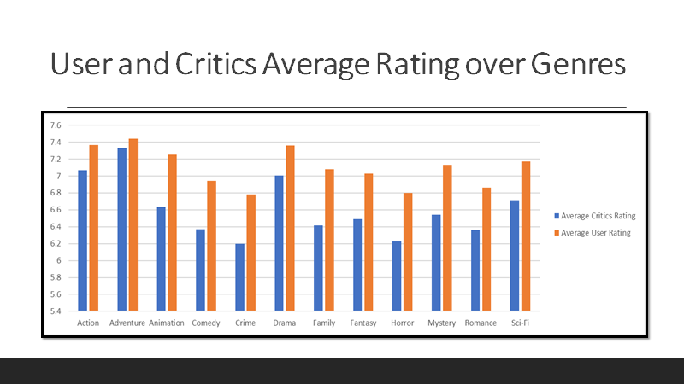

Slide 11
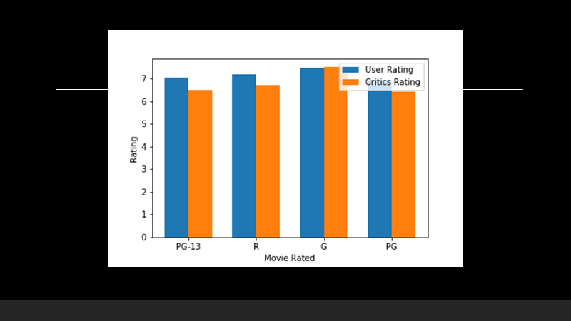

Slide 12
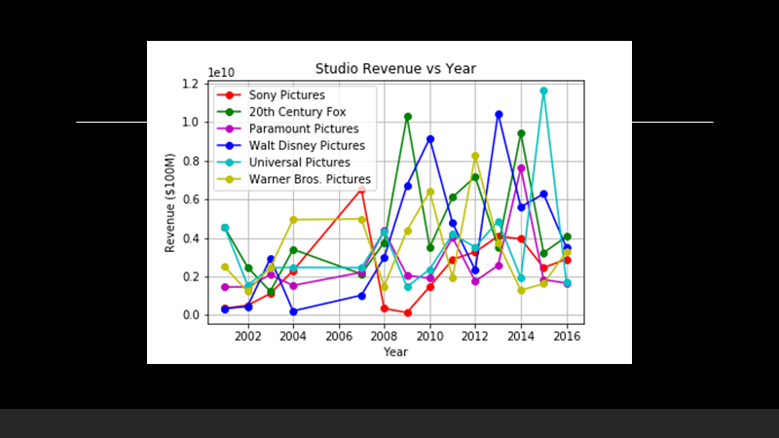

Slide 13
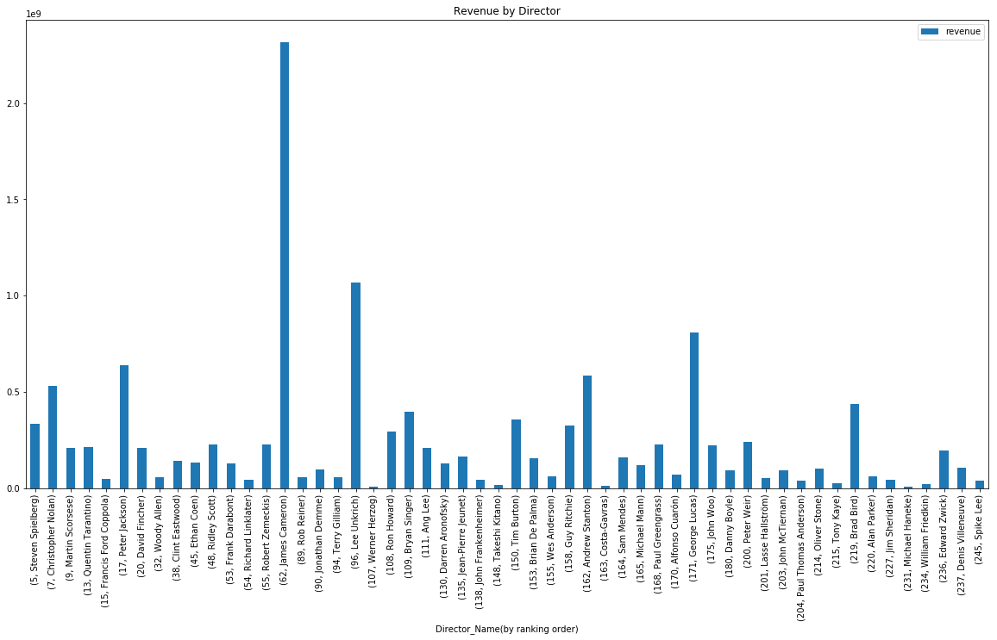
Revenue by Director

Slide 14
CONCLUSION
By comparing our data from 1996 to 2016 we found revenue vs. budget, and revenue vs. ratings to have significant correlations.
No correlation between director popularities and cast popularities on revenue.
Action, Adventure and Animation is the most popular genre.

Slide 15
DATA PROCESS
look up data

Slide 16
ISSUES ALONG THE WAY
Missing data, lot of zero values
Some data set had different named columns, extra columns
Not all data had all countries
Different years for each – all started in 1960 but ended in 2016, 2017, 2013, etc.
Non-linear data – (had to convert x-axis into log to gain insights on correlation)
DIRECTIONS WE COULD GO WITH MORE TIME
Add in more data sets by country – age, ethnicity, gender, education, family size etc.
Perform same analysis back to 1960
Perform analysis for key countries of interest
Create prediction model

Slide 17
Q&A
Example questions:
What is your favorite color?
Where are you from originally?

